Slide 1
Design a kubernetes cluster

Slide 2
Objectives
Node Considerations
Resource Requirements
Network Considerations

Slide 3
Ask
Purpose
. Education
. Development & Testing
. Hosting Production Applications
Cloud or On Prem?
Workloads
How many?
What kind?
. Web
. Big Data/Analytics
Application Resource Requirements
. CPU Intensive
. Memory Intensive
Traffic
. Heavy traffic
. Burst Traffic

Slide 4
Purpose
.Education
.Minikube
.Single node cluster with kubeadm/GCP/AWS
.Development & Testing
.Multi-node cluster with a Single Master and Multiple workers
.Setup using kubeadm tool or quick provision on GCP or AWS or AKS
.Hosting Production Applicatons

Slide 5
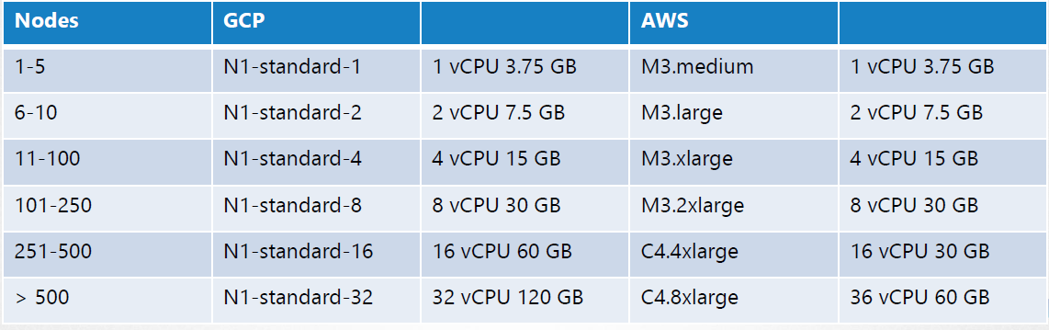
Hosting Production Applications
High Availability Multi node cluster with multiple master nodes
Kubeadm or GCP or Kops on AWS or other supported platforms
Upto5000 nodes
Upto150,000 PODs in the cluster
Upto300,000 Total Containers
Upto100 PODs per Node

Slide 6
Cloud or OnPrem?
Use Kubeadm for on-prem
GKE for GCP
Kops for AWS
Azure Kubernetes Service(AKS) for Azure

Slide 7
Storage
High Performance –SSD Backed Storage
Multiple Concurrent connections –Network based storage
Persistent shared volumes for shared access across multiple PODs
Label nodes with specific disk types
Use Node Selectors to assign applications to nodes with specific disk types

Slide 8
Nodes
Virtual or Physical Machines
Minimum of 4 Node Cluster (Size based on workload)
Master vs Worker Nodes
Linux X86_64 Architecture
Master nodes can host workloads
Best practice is to not host workloads on Master nodes

Slide 9
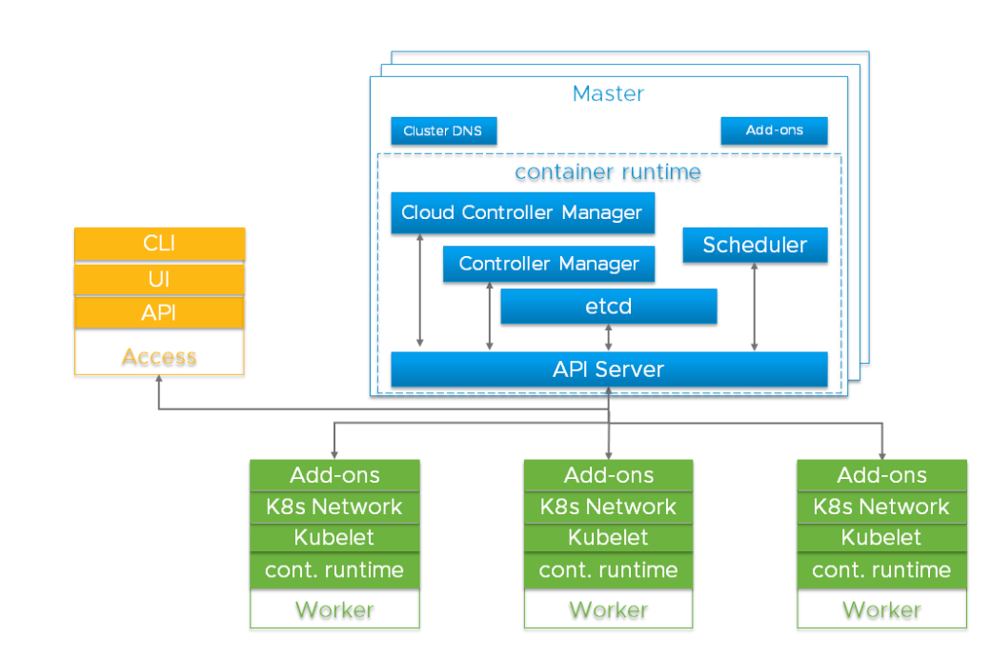
Master & Worker Nodes

Slide 10



Slide 11

KUBEADM
Minikube
Deploys VMs
Requires VMs to be ready
Singe Node Cluster
Singe/Multi Node Cluster

Slide 12
Turnkey Solutions
You Provision VMs
You Configure VMs
You Use Scripts to Deploy Cluster
You Maintain VMs yourself
Eg: Kubernetes on AWS using KOPS
Hosted Solutions
(Managed Solutions)
Kubernetes-As-A-Service
Provider provisions VMs
Provider installs Kubernetes
Provider maintains VMs
Eg: Google Container Engine (GKE)

Slide 13





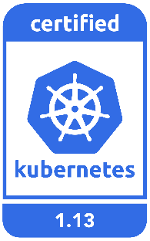


Turnkey Solutions
OpenShift
Cloud Foundry Container Runtime
VMware Cloud PKS
Vagrant

Slide 14

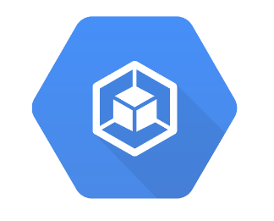

Hosted Solutions
Google Container Engine
(GKE)
Open Shift
Online
Amazon Elastic
Container Service
For kubernetes
(EKS)
Azure Kubernetes
Service

Slide 15








Networking Solution
GCE

Slide 16


Our Design
M
POD CIDR: 10.32.0.0/12
Service CIDR: 10.96.0.0/24
W
W

Slide 17



Getting Started
wget -q --https-only \
"https://github.com/coreos/etcd/releases/download/v3.3.9/etcd-v3.3.9-linux-amd64.tar.gz"
tar -xvf etcd-v3.3.9-linux-amd64.tar.gz
mv etcd-v3.3.9-linux-amd64/etcd* /usr/local/bin/
mkdir -p /etc/etcd /var/lib/etcd
cp ca.pem kubernetes-key.pem kubernetes.pem /etc/etcd/

Slide 18
etcd.service
ExecStart=/usr/local/bin/etcd \\
--name ${ETCD_NAME} \\
--cert-file=/etc/etcd/kubernetes.pem \\
--key-file=/etc/etcd/kubernetes-key.pem \\
--peer-cert-file=/etc/etcd/kubernetes.pem \\
--peer-key-file=/etc/etcd/kubernetes-key.pem \\
--trusted-ca-file=/etc/etcd/ca.pem \\
--peer-trusted-ca-file=/etc/etcd/ca.pem \\
--peer-client-cert-auth \\
--client-cert-auth \\
--initial-advertise-peer-urls https://${INTERNAL_IP}:2380 \\
--listen-peer-urls https://${INTERNAL_IP}:2380 \\
--listen-client-urls https://${INTERNAL_IP}:2379,https://127.0.0.1:2379 \\
--advertise-client-urls https://${INTERNAL_IP}:2379 \\
--initial-cluster-token etcd-cluster-0 \\
ExecStart=/usr/local/bin/etcd \\
--name ${ETCD_NAME} \\
--cert-file=/etc/etcd/kubernetes.pem \\
--key-file=/etc/etcd/kubernetes-key.pem \\
--peer-cert-file=/etc/etcd/kubernetes.pem \\
--peer-key-file=/etc/etcd/kubernetes-key.pem \\
--trusted-ca-file=/etc/etcd/ca.pem \\
--peer-trusted-ca-file=/etc/etcd/ca.pem \\
--peer-client-cert-auth \\
--client-cert-auth \\
--initial-advertise-peer-urls https://${INTERNAL_IP}:2380 \\
--listen-peer-urls https://${INTERNAL_IP}:2380 \\
--listen-client-urls https://${INTERNAL_IP}:2379,https://127.0.0.1:2379 \\
--advertise-client-urls https://${INTERNAL_IP}:2379 \\
--initial-cluster-token etcd-cluster-0 \\
--initial-cluster controller-0=https://${CONTROLLER0_IP}:2380,controller-1=https://${CONTROLLER1_IP}:2380 \\
--initial-cluster-state new \\
--data-dir=/var/lib/etcd
--initial-cluster peer-1=https://${PEER1_IP}:2380,peer-2=https://${PEER2_IP}:2380 \\
--initial-cluster-state new \\
--data-dir=/var/lib/etcd

Slide 19





ETCDCTL
export ETCDCTL_API=3
etcdctl put name john
etcdctl get name
name john
etcdctl get / --prefix --keys-only
name

Slide 20

Number of Nodes
Instances | Quorum | Fault Tolerance
3 | 2 | 1
4 | 3 | 1
5 | 3 | 2
6 | 4 | 2
7 | 4 | 3
1 1 0
ETCD
ETCD
2 2 0
M
M
API
Server
Controller Manager
Scheduler
API
Server
Controller
Manager
Scheduler

Slide 21

Kubernetes Release Binaries
84

Slide 22

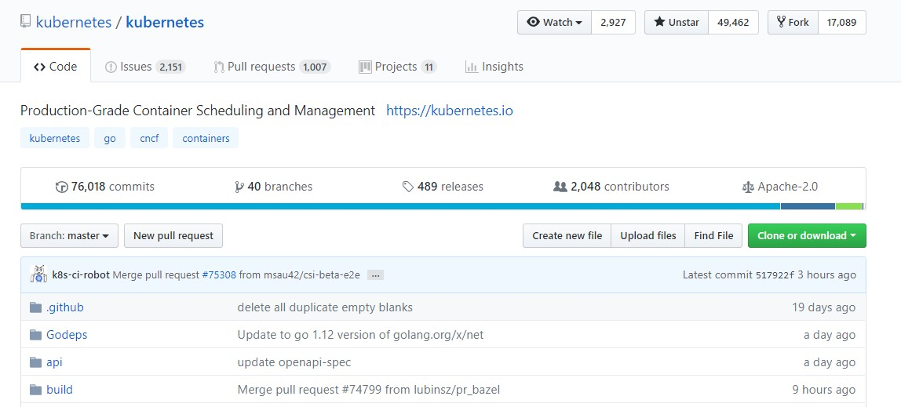


Slide 23
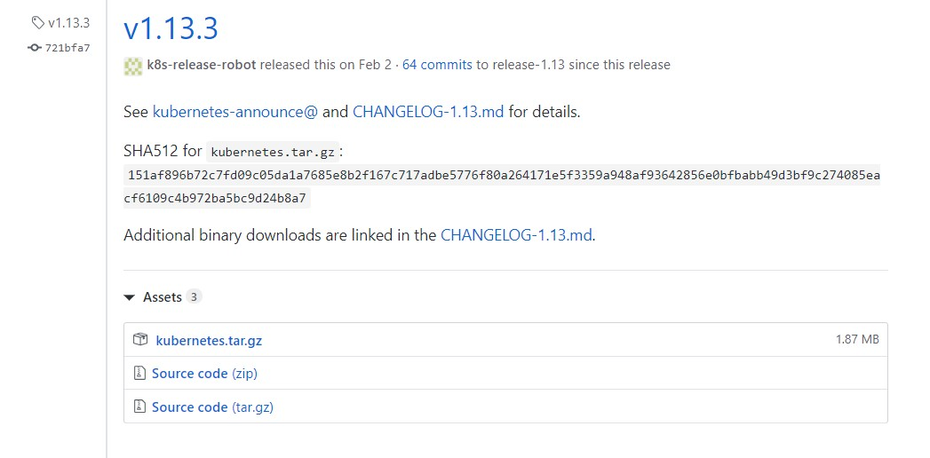

Slide 24



wget https://github.com/kubernetes/kubernetes/releases/download/v1.13.3/kubernetes.tar.gz
kubernetes.tar.gz
tar -xzvf kubernetes.tar.gz
kubernetes
cd kubernetes; ls
client cluster docs hack LICENSES platforms README.md server version
cluster/get-kube-binaries.sh
client/kubernetes-client-linux-amd64.tar.gz server/kubernetes-server-linux-amd64.tar.gz
Extracting /root/kubernetes/client/kubernetes-client-linux-amd64.tar.gz into /root/kubernetes/platforms/linux/amd64 Add '/root/kubernetes/client/bin' to your PATH to use newly-installed binaries.
cd server; tar –zxvf kubernetes-server-linux-amd64.tar.gz
Kubernetes/server

Slide 25

cluster/get-kube-binaries.sh
client/kubernetes-client-linux-amd64.tar.gz server/kubernetes-server-linux-amd64.tar.gz
Extracting /root/kubernetes/client/kubernetes-client-linux-amd64.tar.gz into /root/kubernetes/platforms/linux/amd64 Add '/root/kubernetes/client/bin' to your PATH to use newly-installed binaries.
cd server; tar –zxvf kubernetes-server-linux-amd64.tar.gz
Kubernetes/server
ls kubernetes/server/bin
apiextensions-apiserver cloud-controller-manager kubectl
kubelet
hyperkube
kubeadm
kube-apiserver kube-scheduler
kube-scheduler.docker_tag
kube-controller-manager
kube-proxy.docker_tag
kube-controller-manager.tar cloud-controller-manager.tar
mounter
kube-proxy.tar kube-apiserver.tar
kube-proxy
kube-scheduler.tar

Slide 26
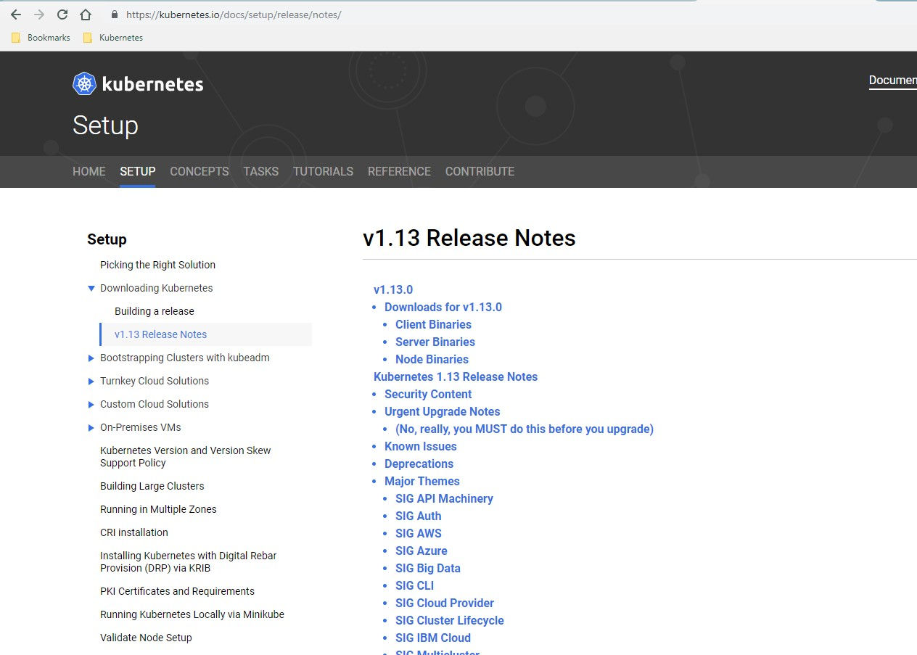

Slide 27
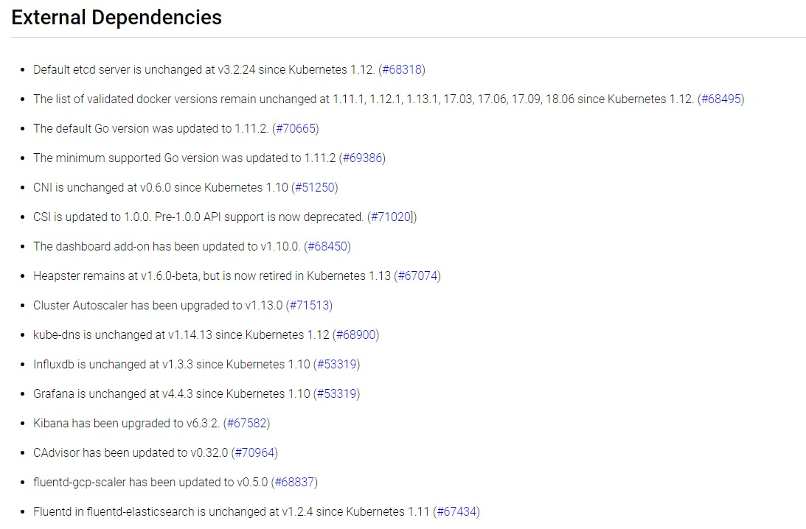

Slide 28
Our Design
HAPRoxy
LB
Deploy ETCD Cluster
Deploy Control Plane Components
Network Loadbalancer
API
Server
API
Server
ETCD
ETCD
M
M
Controller Manager
Controller
Manager
Scheduler
Scheduler
W
W

Slide 29
Install Worker Nodes
104

Slide 30
Our Design
HAPRoxy
LB
Deploy ETCD Cluster
Deploy Control Plane Components
Network Loadbalancer
API
Server
API
Server
ETCD
ETCD
M
M
Controller Manager
Controller
Manager
Scheduler
Scheduler
Generate CERTs for Worker-1
Configure Kubelet for Worker-1
Renew Certificates
Configure kube-proxy
kubelet
kubelet
TLS Bootstrap:
Worker-2 to create and configure certificates by itself
Configure Kubelet for Worker-2
Worker-2 to renew certificates by itself
Configure kube-proxy
Kube-proxy
Kube-proxy
W
W

Slide 31
TLS Bootstrap Kubelet
109

Slide 32

Our Design
HAPRoxy
LB
Deploy ETCD Cluster
Deploy Control Plane Components
Network Loadbalancer
API
Server
API
Server
ETCD
ETCD
M
M
Controller Manager
Controller
Manager
Scheduler
Scheduler
Generate CERTs for Worker-1
Configure Kubelet for Worker-1
Renew Certificates
Configure kube-proxy
kubelet
TLS Bootstrap:
Worker-2 to create and configure certificates by itself
Configure Kubelet for Worker-2
Worker-2 to renew certificates by itself
Configure kube-proxy
Kube-proxy
W
W

Slide 33




system:bootstrappers
system:nodes
M
Submit CSR?
system:node-bootstrapper
Auto Approve CSR?
certificatesigningrequests:nodeclient
kubectl get csr
Auto Renew CSR? certificatesigning
requests:selfnodeclient
NAME
node-csr-VnzfkE6WdOMOna_S7jIuMTtQzu1-utgAA5gbk3dooUY
AGE REQUESTOR CONDITION
13m system:bootstrap:07401b Approved,Issued
Create Bootstrap Token and associate it to group system:bootstrappers
Assign Role – system:node-bootstrapper to group system:bootstrappers
Assign Role - system:certificates.k8s.io:certificatesigningrequests:nodeclient to group system:bootstrappers
Assign Role - system:certificates.k8s.io:certificatesigningrequests:selfnodeclient to group system:nodes

Slide 34
bootstrap-kubeconfig
apiVersion: v1
clusters:
- cluster:
certificate-authority: /var/lib/kubernetes/ca.crt
server: https://192.168.5.30:6443
name: bootstrap
contexts:
- context:
cluster: bootstrap
user: kubelet-bootstrap
name: bootstrap
current-context: bootstrap
kind: Config preferences: {} users:
- name: kubelet-bootstrap
user: token: 07401b.f395accd246ae52d
W
kubelet.service
ExecStart=/usr/local/bin/kubelet \\
--config=/var/lib/kubelet/kubelet-config.yaml \\
--image-pull-progress-deadline=2m \\
--bootstrap-kubeconfig="/var/lib/kubelet/bootstrap-kubeconfig" \\
--tls-cert-file=/var/lib/kubelet/worker-1.crt \\
--tls-private-key-file=/var/lib/kubelet/worker-1.key \\
--network-plugin=cni \\
--register-node=true \\
--v=2
ExecStart=/usr/local/bin/kubelet \\
--config=/var/lib/kubelet/kubelet-config.yaml \\
--image-pull-progress-deadline=2m \\
--kubeconfig=/var/lib/kubelet/kubeconfig \\
--tls-cert-file=/var/lib/kubelet/worker-1.crt \\
--tls-private-key-file=/var/lib/kubelet/worker-1.key \\
--network-plugin=cni \\
--register-node=true \\
--v=2

Slide 35
bootstrap-kubeconfig
apiVersion: v1
clusters:
- cluster:
certificate-authority: /var/lib/kubernetes/ca.crt
server: https://192.168.5.30:6443
name: bootstrap
contexts:
- context:
cluster: bootstrap
user: kubelet-bootstrap
name: bootstrap
current-context: bootstrap
kind: Config preferences: {} users:
- name: kubelet-bootstrap
user: token: 07401b.f395accd246ae52d
W
kubelet.service
ExecStart=/usr/local/bin/kubelet \\
--config=/var/lib/kubelet/kubelet-config.yaml \\
--image-pull-progress-deadline=2m \\
--bootstrap-kubeconfig="/var/lib/kubelet/bootstrap-kubeconfig" \\
--rotate-certificates=true \\
--tls-cert-file=/var/lib/kubelet/worker-1.crt \\
--tls-private-key-file=/var/lib/kubelet/worker-1.key \\
--network-plugin=cni \\
--register-node=true \\
--v=2
ExecStart=/usr/local/bin/kubelet \\
--config=/var/lib/kubelet/kubelet-config.yaml \\
--image-pull-progress-deadline=2m \\
--kubeconfig=/var/lib/kubelet/kubeconfig \\
--tls-cert-file=/var/lib/kubelet/worker-1.crt \\
--tls-private-key-file=/var/lib/kubelet/worker-1.key \\
--network-plugin=cni \\
--register-node=true \\
--v=2

Slide 36
bootstrap-kubeconfig
apiVersion: v1
clusters:
- cluster:
certificate-authority: /var/lib/kubernetes/ca.crt
server: https://192.168.5.30:6443
name: bootstrap
contexts:
- context:
cluster: bootstrap
user: kubelet-bootstrap
name: bootstrap
current-context: bootstrap
kind: Config preferences: {} users:
- name: kubelet-bootstrap
user: token: 07401b.f395accd246ae52d
W
Client Certs
kubelet.service
ExecStart=/usr/local/bin/kubelet \\
--config=/var/lib/kubelet/kubelet-config.yaml \\
--image-pull-progress-deadline=2m \\
ExecStart=/usr/local/bin/kubelet \\
--config=/var/lib/kubelet/kubelet-config.yaml \\
--image-pull-progress-deadline=2m \\
--tls-cert-file=/var/lib/kubelet/worker-1.crt \\
--tls-private-key-file=/var/lib/kubelet/worker-1.key \\
--network-plugin=cni \\
--register-node=true \\
--v=2
ExecStart=/usr/local/bin/kubelet \\
--config=/var/lib/kubelet/kubelet-config.yaml \\
--image-pull-progress-deadline=2m \\
--kubeconfig=/var/lib/kubelet/kubeconfig \\
--tls-cert-file=/var/lib/kubelet/worker-1.crt \\
--tls-private-key-file=/var/lib/kubelet/worker-1.key \\
--network-plugin=cni \\
--register-node=true \\
--v=2
ExecStart=/usr/local/bin/kubelet \\
--config=/var/lib/kubelet/kubelet-config.yaml \\
--image-pull-progress-deadline=2m \\
--tls-cert-file=/var/lib/kubelet/worker-1.crt \\
--tls-private-key-file=/var/lib/kubelet/worker-1.key \\
--network-plugin=cni \\
--register-node=true \\
--v=2
--bootstrap-kubeconfig="/var/lib/kubelet/bootstrap-kubeconfig" \\
--rotate-certificates=true \\
--rotate-server-certificates=true \\
--network-plugin=cni \\
--register-node=true \\
--v=2

Slide 37


Server Certs
Client Certs
CSR Approval Manual
CSR Approval Automatic
kubectl get csr
NAME | AGE | REQUESTOR | CONDITION
csr-x254z | 13m | system:node:worker-2 | Pending
node-csr-VnzfkE6WdOMOna_S7jIuMTtQzu1-utgAA5gbk3dooUY | 13m | system:bootstrap:07401b | Approved,Issued
kubectl certificate approve csr-x254z
csr-x254z approved!

Slide 38
Node end-to-end Tests
128

Slide 39


Test - Manual
kubectl get nodes
NAME
worker-1 worker-2
STATUS
Ready Ready
ROLES
<none>
<none>
AGE VERSION
8d v1.13.0
8d v1.13.0
kubectl get pods
NAMESPACE | NAME | READY | STATUS | RESTARTS | AGE
kube-system | coredns-69cbb76ff8-9p45d | 1/1 | Running | 1 | 8d
kube-system | coredns-69cbb76ff8-rmhzt | 1/1 | Running | 0 | 8d
kube-system | weave-net-58j2j | 2/2 | Running | 2 | 8d
kube-system | weave-net-rr5dk | 2/2 | Running | 2 | 8d

Slide 40

Test - Manual
kubectl get pods -n kube-system
NAME | READY | STATUS | RESTARTS | AGE
coredns-78fcdf6894-5dntv | 1/1 | Running | 0 | 1h
coredns-78fcdf6894-knpzl | 1/1 | Running | 0 | 1h
etcd-master | 1/1 | Running | 0 | 1h
kube-apiserver-master | 1/1 | Running | 0 | 1h
kube-controller-manager-master | 1/1 | Running | 0 | 1h
kube-proxy-fvbpj | 1/1 | Running | 0 | 1h
kube-proxy-v5r2t | 1/1 | Running | 0 | 1h
kube-scheduler-master | 1/1 | Running | 0 | 1h
weave-net-7kd52 | 2/2 | Running | 1 | 1h
weave-net-jtl5m | 2/2 | Running | 1 | 1h

Slide 41



Test - Manual
service kube-apiserver status
kube-apiserver.service - Kubernetes API Server
Loaded: loaded (/etc/systemd/system/kube-apiserver.service; enabled; vendor preset: enabled) Active: active (running) since Wed 2019-03-20 07:57:25 UTC; 1 weeks 1 days ago
Docs: https://github.com/kubernetes/kubernetes Main PID: 15767 (kube-apiserver)
Tasks: 13 (limit: 2362)
service kube-controller-manager status
kube-controller-manager.service - Kubernetes Controller Manager
Loaded: loaded (/etc/systemd/system/kube-controller-manager.service; enabled; vendor preset: enabled) Active: active (running) since Wed 2019-03-20 07:57:25 UTC; 1 weeks 1 days ago
Docs: https://github.com/kubernetes/kubernetes
Main PID: 15771 (kube-controller) Tasks: 10 (limit: 2362)
service kube-scheduler status
kube-scheduler.service - Kubernetes Scheduler
Loaded: loaded (/etc/systemd/system/kube-scheduler.service; enabled; vendor preset: enabled) Active: active (running) since Fri 2019-03-29 01:45:32 UTC; 11min ago
Docs: https://github.com/kubernetes/kubernetes Main PID: 28390 (kube-scheduler)
Tasks: 10 (limit: 2362)

Slide 42


Test - Manual
service kubelet status
kubelet.service - Kubernetes Kubelet
Loaded: loaded (/etc/systemd/system/kubelet.service; enabled; vendor preset: enabled) Active: active (running) since Wed 2019-03-20 14:22:06 UTC; 1 weeks 1 days ago
Docs: https://github.com/kubernetes/kubernetes Main PID: 1281 (kubelet)
Tasks: 24 (limit: 1152)
service kube-proxy status
kube-proxy.service - Kubernetes Kube Proxy
Loaded: loaded (/etc/systemd/system/kube-proxy.service; enabled; vendor preset: enabled) Active: active (running) since Wed 2019-03-20 14:21:54 UTC; 1 weeks 1 days ago
Docs: https://github.com/kubernetes/kubernetes
Main PID: 794 (kube-proxy) Tasks: 7 (limit: 1152)

Slide 43




Test - Manual
kubectl run nginx
deployment.apps/nginx created
kubectl get pods
NAME | READY | STATUS | RESTARTS | AGE
nginx-7cdbd8cdc9-g5q8d | 1/1 | Running | 0 | 19s
kubectl scale --replicas=3 deploy/nginx
deployment.extensions/nginx scaled
kubectl get pods
NAME | READY | STATUS | RESTARTS | AGE | IP | NODE | NOMINATED NODE | READINESS GATES
nginx-7cdbd8cdc9-djj6x | 1/1 | Running | 0 | 74s | 10.40.0.5 | worker-2 | <none> | <none>
nginx-7cdbd8cdc9-g5q8d | 1/1 | Running | 0 | 3m29s | 10.32.0.5 | worker-1 | <none> | <none>
nginx-7cdbd8cdc9-rsskt | 1/1 | Running | 0 | 74s | 10.32.0.6 | worker-1 | <none> | <none>

Slide 44


Test - Manual
kubectl expose deployment nginx --port=80 --type=NodePort
service/nginx exposed
kubectl get service
NAME TYPE CLUSTER-IP EXTERNAL-IP PORT(S) AGE
kubernetes ClusterIP 10.96.0.1 <none> 443/TCP 8d
nginx NodePort 10.96.0.88 <none> 80:31850/TCP 3s
curl http://worker-1:31850
...
<h1>Welcome to nginx!</h1>
...

Slide 45
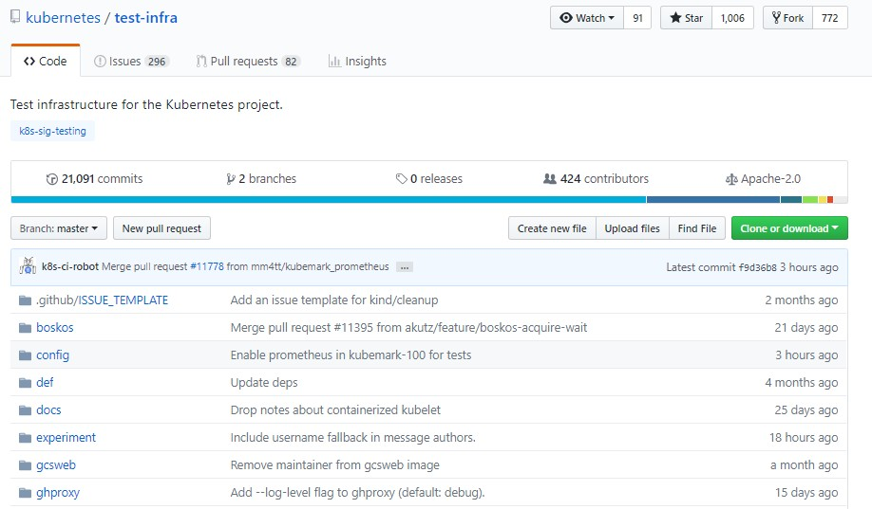
kubetest

Slide 46
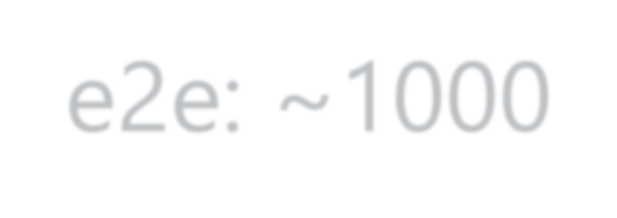
kubetest - Tests
e2e: ~1000
sig-api-machinery
sig-apps
sig-auth
sig-cli
sig-network
sig-scheduling
sig-storage

Slide 47
kubetest - Tests
sig-api-machinery
sig-apps
sig-auth
sig-cli
sig-network
sig-scheduling
sig-storage
Networking should function for intra-pod communication (http)
Services should serve a basic endpoint from pods
Service endpoints latency should not be very high
DNS should provide DNS for services
Secrets should be consumable in multiple volumes in a pod
Secrets should be consumable from pods in volume with mappings
ConfigMap should be consumable from pods in volume

Slide 48
kubetest - Tests
Networking should function for intra-pod communication (http)
[sig-network] Networking Granular Checks: Pods
Prepare: Creates a namespace for this test
Creates Test Pod in this namespace
Waits for the PODs to come up
Test: Executes curl on one pod to reac the IP of another over HTTP
Record the result
Cleanup: Delete the namespace
should function for intra-pod communication: http [NodeConformance] [Confo
STEP: Building a namespace api object
STEP: Performing setup for networking test in namespace e2e-tests-pod-networ
Mar 14 11:35:19.315: INFO: Waiting up to 10m0s for all (but 0) nodes to be s
STEP: Creating test pods
h
Mar 14 11:35:39.522: INFO: ExecWithOptions {Command:[/bin/sh -c curl -g -q -
'http://10.32.0.8:8080/dial?request=hostName&protocol=http&host=10.32.0.7&po
drstd PodName:host-test-container-pod ContainerName:hostexec Stdin:<nil> Cap
PreserveWhitespace:false}
Mar 14 11:35:39.522: INFO: >>> kubeConfig: /root/.kube/config Mar 14 11:35:39.656: INFO: Waiting for endpoints: map[]
Mar 14 11:35:39.660: INFO: ExecWithOptions {Command:[/bin/sh -c curl -g -q - 'http://10.32.0.8:8080/dial?request=hostName&protocol=http&host=10.38.0.12&p drstd PodName:host-test-container-pod ContainerName:hostexec Stdin:<nil> Cap PreserveWhitespace:false}
Mar 14 11:35:39.660: INFO: >>> kubeConfig: /root/.kube/config
STEP: Destroying namespace "e2e-tests-pod-network-test-drstd" for this suite

Slide 49









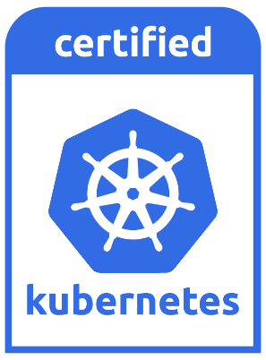
Kubernetes Test-Infra
Build
Deploy Test
Cleanup
My-kubeadm.sh

Slide 50


Kubetest - Tests
e2e: ~1000
conformance: ~160

Slide 51
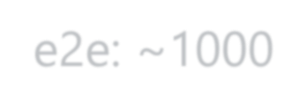

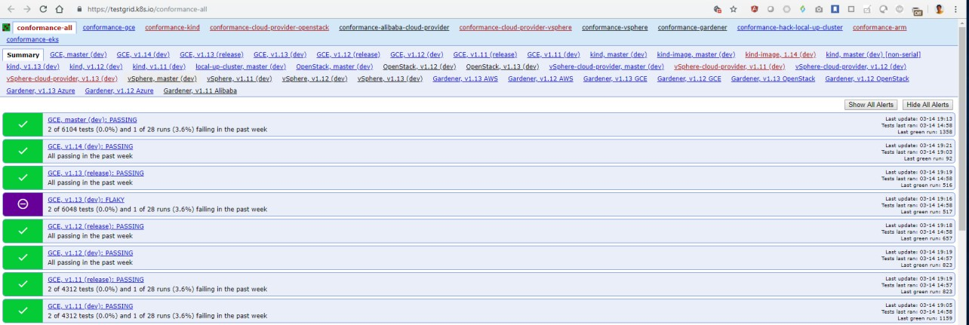
Kubetest - Tests
e2e: ~1000
conformance: ~160

Slide 52
Kubetest - Time
Full e2e = ~1000 Tests / 12 Hours
Conformance = 164 Tests / 1.5 hours

Slide 53


Slide 54
Run & Analyze E2E Tests
146

Slide 55





kubetest- Run
go get -u k8s.io/test-infra/kubetest
kubetest --extract=v1.11.3
Note: Version must match the kubernetes server version
kubernetes
cd kubernetes
export KUBE_MASTER_IP=“192.168.26.10:6443”
export KUBE_MASTER=kube-master
kubetest --test --provider=skeleton > testout.txt
kubetest --test --provider=skeleton --test_args="--ginkgo.focus=Secrets" > testout.txt
kubetest --test --provider=skeleton --test_args="--ginkgo.focus=\[Conformance\]" > testout.txt

Slide 56

kubetest- Run
kubetest --test --provider=skeleton --test_args="--ginkgo.focus=\[Conformance\]" > testout.txt
cat testout.txt
Client Version: version.Info{Major:"1", Minor:"11", GitVersion:"v1.11.8", GitCommit:"4e209c9383fa00631d124c8adcc011d617339b3c", GitTreeState:"clean", BuildDate:"2019-02-28T18:49:34Z",
GoVersion:"go1.10.8", C ompiler:"gc", Platform:"linux/amd64"}
Server Version: version.Info{Major:"1", Minor:"11", GitVersion:"v1.11.8", GitCommit:"4e209c9383fa00631d124c8adcc011d617339b3c", GitTreeState:"clean", BuildDate:"2019-02-28T18:40:05Z",
GoVersion:"go1.10.8", C ompiler:"gc", Platform:"linux/amd64"}
Setting up for KUBERNETES_PROVIDER="skeleton".
Mar 14 11:16:12.419: INFO: Overriding default scale value of zero to 1
Mar 14 11:16:12.419: INFO: Overriding default milliseconds value of zero to 5000
I0314 11:16:12.674596 20093 e2e.go:333] Starting e2e run "933b1eae-464a-11e9-81ea-02f0aa2d49f4" on Ginkgo node 1 Running Suite: Kubernetes e2e suite
===================================
Random Seed: 1552562172 - Will randomize all specs Will run 167 of 1008 specs
Mar 14 11:16:12.731: INFO: >>> kubeConfig: /root/.kube/config
Mar 14 11:16:12.745: INFO: Waiting up to 30m0s for all (but 0) nodes to be schedulable
Mar 14 11:16:12.770: INFO: Waiting up to 10m0s for all pods (need at least 0) in namespace 'kube-system' to be running and ready
Mar 14 11:16:12.831: INFO: 12 / 13 pods in namespace 'kube-system' are running and ready (0 seconds elapsed) Mar 14 11:16:12.831: INFO: expected 2 pod replicas in namespace 'kube-system', 2 are Running and Ready.

Slide 57
[SLOW TEST:8.486 seconds]
k
[sig-storage] EmptyDir volumes
ubetest- Run
/workspace/anago-v1.11.8-
beta.0.41+4e209c9383fa00/src/k8s.io/kubernetes/_output/dockerized/go/src/k8s.io/kubernetes/test/e2e/common/empty_dir.g
o:40
should support (root,0777,tmpfs) [NodeConformance] [Conformance]
/workspace/anago-v1.11.8- beta.0.41+4e209c9383fa00/src/k8s.io/kubernetes/_output/dockerized/go/src/k8s.io/kubernetes/test/e2e/framework/framewor k.go:684
SSMar 14 13:01:15.397: INFO: Running AfterSuite actions on all node Mar 14 13:01:15.397: INFO: Running AfterSuite actions on node 1
Summarizing 2 Failures:
[Fail] [sig-network] DNS [It] should provide DNS for services [Conformance]
/workspace/anago-v1.11.8- beta.0.41+4e209c9383fa00/src/k8s.io/kubernetes/_output/dockerized/go/src/k8s.io/kubernetes/test/e2e/network/dns_common
.go:497
[Fail] [sig-network] DNS [It] should provide DNS for the cluster [Conformance]
/workspace/anago-v1.11.8- beta.0.41+4e209c9383fa00/src/k8s.io/kubernetes/_output/dockerized/go/src/k8s.io/kubernetes/test/e2e/network/dns_common
.go:497
Ran 166 of 1008 Specs in 6302.670 seconds
FAIL! -- 164 Passed | 2 Failed | 0 Pending | 842 Skipped --- FAIL: TestE2E (6302.72s)
FAIL
Ginkgo ran 1 suite in 1h45m3.31433997s Test Suite Failed

Slide 58
Replication Controller
Controllers are the brain behind Kubernetes.
They are processes that monitor kubernetes objects and respond accordingly.
High Availability
Load balancing
Scale

Slide 59
kubectl
Kubectl run ngnix --image nginx
Kubectl get pods
Kubectl describe pod nginx

Slide 60
ConfigMaps
ConfigMap
pod-definition.yaml
apiVersion: v1 kind: Pod metadata:
name: simple-webapp-color
spec:
containers:
name: simple-webapp-color image: simple-webapp-color ports:
containerPort: 8080
env:
_{name:} APP_COLOR
value: blue
name: APP_MODE
value: prod

Slide 61
ConfigMaps
ConfigMap
pod-definition.yaml
APP_COLOR : blue
APP_MODE : prod
apiVersion: v1 kind: Pod metadata:
name: simple-webapp-color
spec:
containers:
- name: simple-webapp-color image: simple-webapp-color ports:
- containerPort: 8080
envFrom:
- configMapRef:
name: app-config
APP_COLOR: blue
APP_MODE: prod
env:
- name: value:
- name: value:
1
Create ConfigMap
2
Inject into Pod

Slide 62


Create ConfigMaps
ConfigMap
Imperative
kubectl create configmap
APP_COLOR: blue APP_MODE: prod
Declarative
kubectl create –f
1
Create ConfigMap

Slide 63








Create ConfigMaps
ConfigMap
Imperative
kubectl create configmap
APP_COLOR: blue APP_MODE: prod
<config-name> --from-literal=<key>=<value>
kubectl create configmap \
app-config --from-literal=APP_COLOR=blue \
--from-literal=APP_MOD=prod
kubectl create configmap
1
Create ConfigMap
<config-name> --from-file=<path-to-file>
kubectl create configmap \
app-config --from-file=app_config.properties

Slide 64


Create ConfigMaps
ConfigMap
Declarative
kubectl create –f
APP_COLOR: blue APP_MODE: prod
config-map.yaml
apiVersion: v1 kind: ConfigMap metadata:
name: app-config data:
APP_COLOR: blue APP_MODE: prod
1
Create ConfigMap
kubectl create –f config-map.yaml

Slide 65


View ConfigMaps
kubectl get configmaps
NAME DATA
app-config 2
AGE
3s
kubectl describe configmaps
Name: app-config Namespace: default Labels: <none> Annotations: <none>
Data
==== APP_COLOR:
blue APP_MODE:
prod
Events: <none>

Slide 66
ConfigMap in Pods
envFrom:
- configMapRef:
name: app-config
ENV
env:
- name: APP_COLOR
valueFrom:
configMapKeyRef: name: app-config
key: APP_COLOR
SINGLE ENV
volumes:
- name: app-config-volume
configMap:
name: app-config
VOLUME

Slide 67
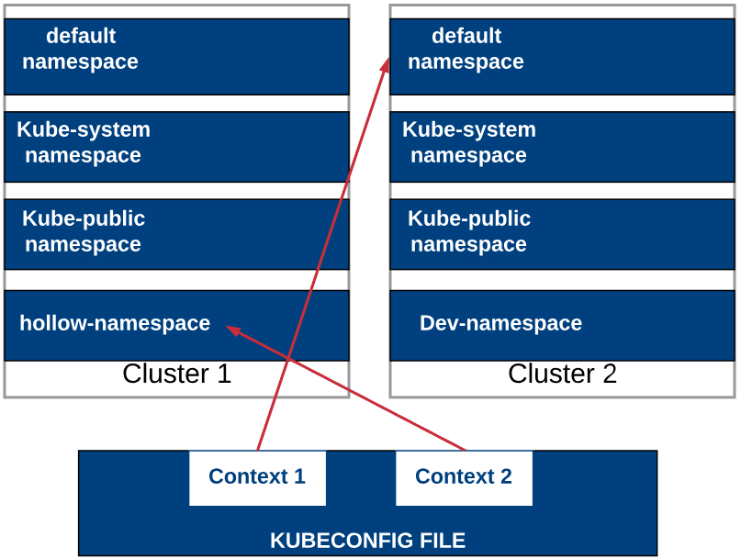
Namespaces

Slide 68
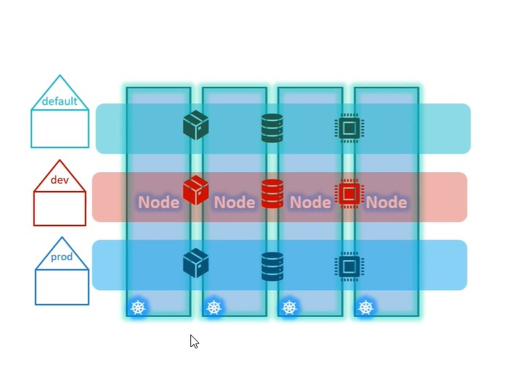
Namespace

Slide 69
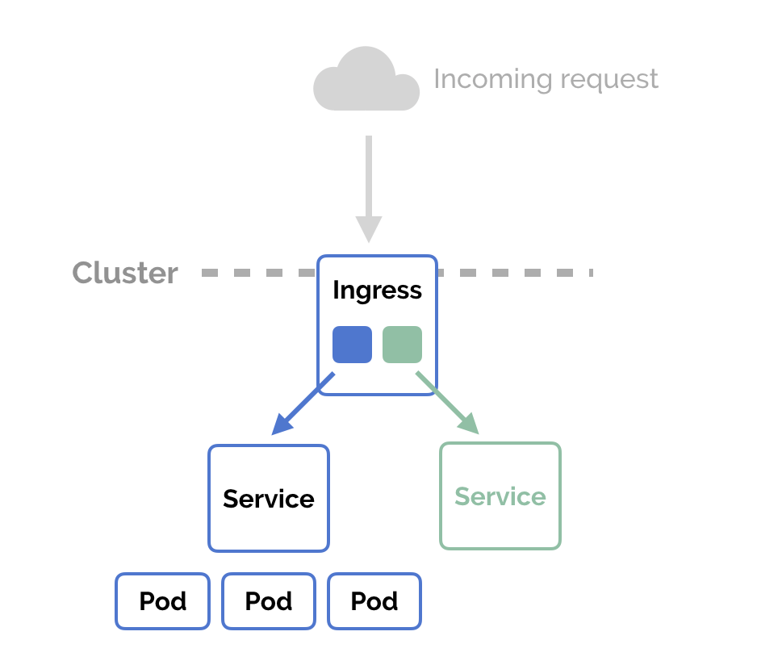
Ingress
Ingress is an API object that defines the traffic routing rules (e.g. load balancing, SSL termination, path-based routing, protocol), whereas

Slide 70
Ingress Controller
A Kubernetes Ingress controller is a specialized load balancer for Kubernetes environments.
Are configured using the Kubernetes API to deploy objects called “Ingress Resources” Monitor the pods running in Kubernetes and automatically update the load‑balancing rules when pods are added or removed from a service.
Ingress Controller is the component responsible for fulfilling those requests of ingress
An ingress controller is responsible for reading the Ingress Resource information and processing that data accordingly.

Slide 71
Kubernetes API Primitives
Kubernetes API primitive, also known as Kubernetes objects, are the basic building blocks of any application running in Kubernetes
Examples:
Pod
Node
Service
Service Account
Two primary members
Spec, desired state
Status, current state

Slide 72
Kubernetes API
The Kubernetes API is the front end of the Kubernetes control plane and is how users interact with their Kubernetes cluster.
The API (application programming interface) server determines if a request is valid and then processes it.
In essence, the API is the interface used to manage, create, and configure Kubernetes clusters.
It's how the users, external components, and parts of your cluster all communicate with each other.

Slide 73
How API Works
The core of Kubernetes' control plane is the API server.
The API server exposes an HTTP API that lets end users, different parts of your cluster, and external components communicate with one another.
The Kubernetes API lets you query and manipulate the state of API objects in Kubernetes (for example: Pods, Namespaces, ConfigMaps, and Events).
Most operations can be performed through the kubectl command-line interface or other command-line tools, such as kubeadm, which in turn use the API.

Slide 74
API Versioning
Three tiers of api maturity levels also referenced within the object apiVersion.
Alpha
The software may contains bugs
Enabling a feature may expose bugs
Support for a feature may be dropped at any time without notice
Beta
The software is well tested
Enabling feature is considered safe
The support for a feature will not be dropped, though details may change
Stable
Released, stable and api schema will not change
The stable versions of feature appear in released software for many subsequent versions.

Slide 75
Object model
Objects are a persistent entity that represent the desired state of the object within the cluster.
All objects must have
apiVersion
Kind
Metadata
Spec
apiVersion: v1
kind: Pod
metadata:
name: memory-demo
spec:
containers:
- name: memory-demo-ctr
image: polinux

Slide 76
Object Model requirement
apiVersion - Which version of the Kubernetes API you're using to create this object
kind - What kind of object you want to create
metadata - Data that helps uniquely identify the object, including a name string, UID, and optional namespace
spec - What state you desire for the object. The precise format of the object spec is different for every Kubernetes object, and contains nested fields specific to that object.

Slide 77
Object expression YAML
Files or other representations of kubernetes objects are generally represented in YAML.
A human friendly data serialization standard
User white space alignment to denote ownership
Three basic data types:
Mappings : hash or dictionary
Sequences: array or list
Scalars: string, number, Boolean etc

Slide 78
Object expression YAML
ApiVersion: v1 → scalar
Kind: Pod
Metadata
name: test → Mapping Hash Dictionary
Spec
containers: → Sequence array list
name:
image

